Slide 1
An introduction to transporting treatment effects from randomized clinical trials to clinical practice
Society for Epidemiologic Research Workshop
Friday, January 8th, 2020
Jennifer L. Lund
University of North Carolina at Chapel Hill

Slide 2
Overview
The workshop team and logistics
An introduction to the concepts of generalizability and transportability in epidemiologic research
Workshop example and the clinical context
Application: Visualizations and break-out groups
Wrap-up: Discussion and questions

Slide 3






Workshop team
Jennifer Lund
Michael Webster-Clark
Shahar Shmuel
Alexander Keil
Allison Musty
Daniel Westreich

Slide 4
Workshop logistics
Lecture / webinar (45-50 minutes)
Interactive application (60 minutes)
Discussion and Q&A (10-15 minutes)

Slide 5
Interactive application
Zoom breakout rooms
Groups of 5-6 individuals have been pre-assigned
There will be two break-outs of 10-minutes each
Google slides
Will be used to allow break-out groups to record responses during discussion
Assign a scribe to record responses/discussion
Link here: https://docs.google.com/presentation/d/1mDR9ed1O565E8w4uFmTqWyq3D-bEAM2cg-tZvKRKcXo/edit?usp=sharing
Notes:
https://docs.google.com/presentation/d/1mDR9ed1O565E8w4uFmTqWyq3D-bEAM2cg-tZvKRKcXo/edit?usp=sharing

Slide 6
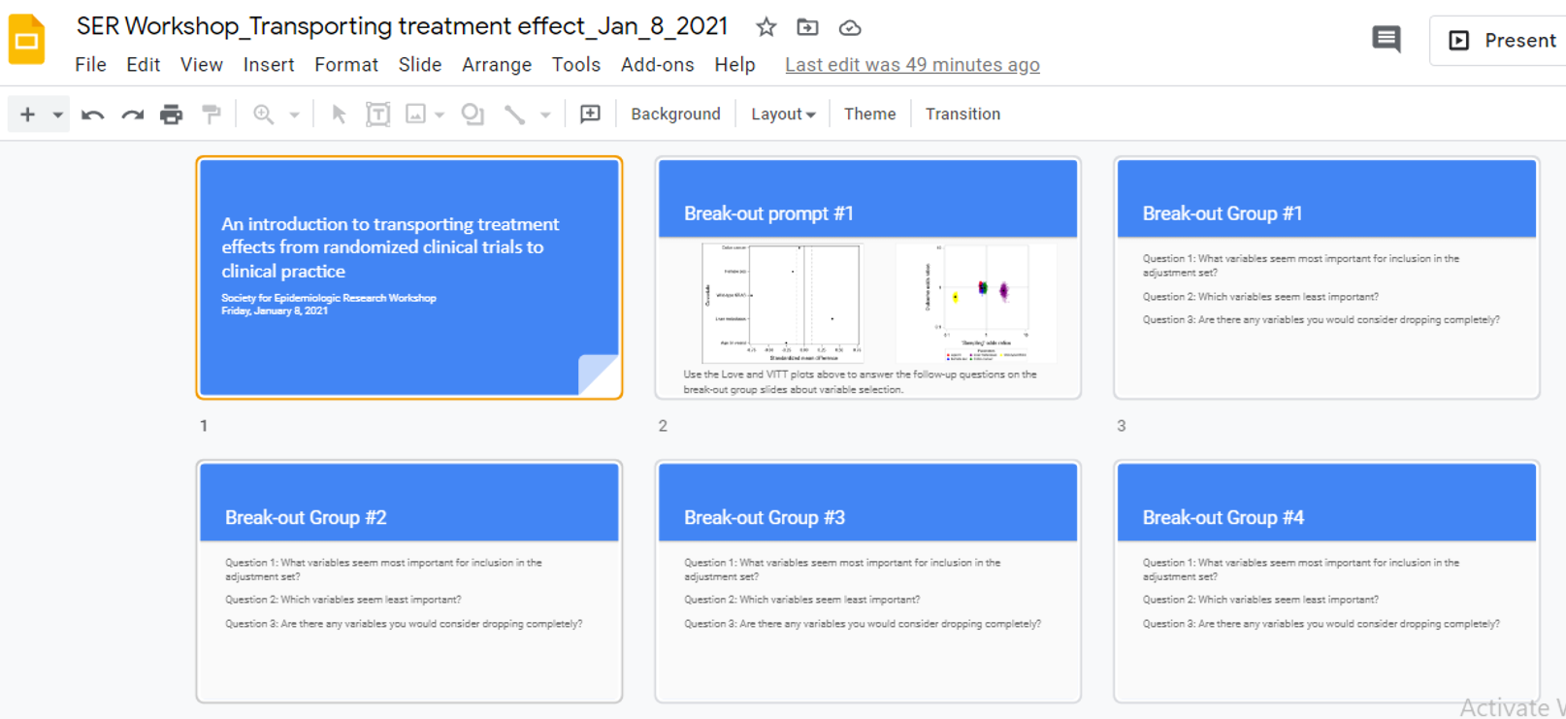
Google Slides

Slide 7
Programs and course content
All materials required for the workshop were sent to you in an email on January 7, 2021
Any updates or changes to course content will be maintained on the following GitHub site: https://github.com/CIRL-UNC/HybridDesignVisualsWorkshop
Please note: we cannot store the datasets on the GitHub site, as they require approval for use

Slide 8
Questions?

Slide 9
Workshop example and clinical context

Slide 10
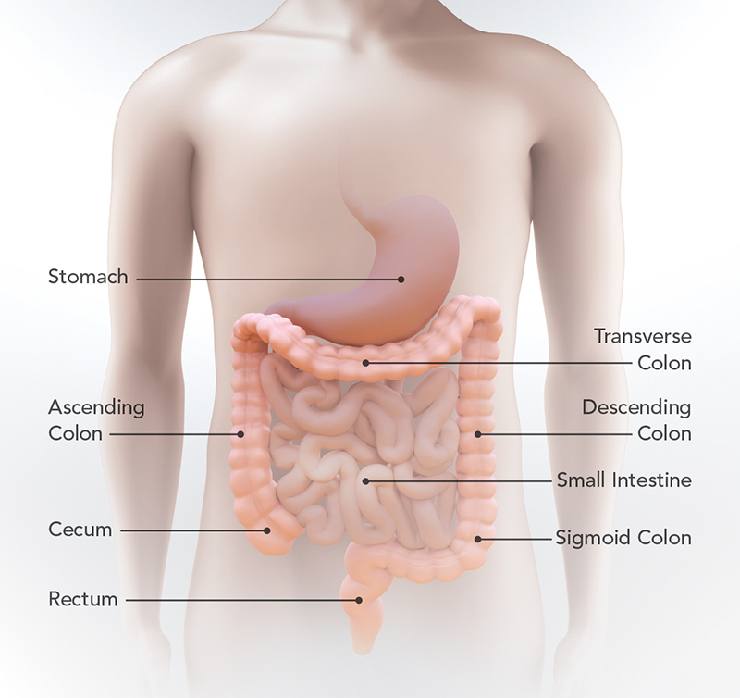
Example: Metastatic Colorectal Cancer
Colorectal cancer (CRC) is the third most common cancer in US men and women
About 22% are diagnosed when they have already metastasized (mCRC)
Prognosis is poor in mCRC with a 5-year survival rate of 14%

Slide 11
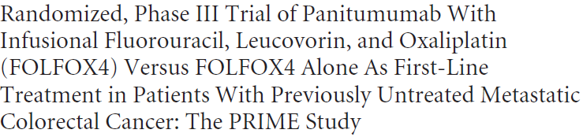
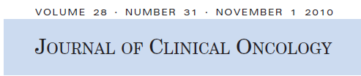
Open-label, phase III, multi-center trial comparing the efficacy of panitumimab + FOLFOX4 versus FOLFOX4 alone
Panitumimab is a monoclonal antibody therapy targeting the epidermal growth factor receptor (EGFR), shown to be a clinically meaningful target for mCRC
FOLFOX4 is an infused chemotherapy regimen including a combination of oxaliplatin and 5-fluorouracil, and was standard of care for mCRC at the time of this trial

Slide 12
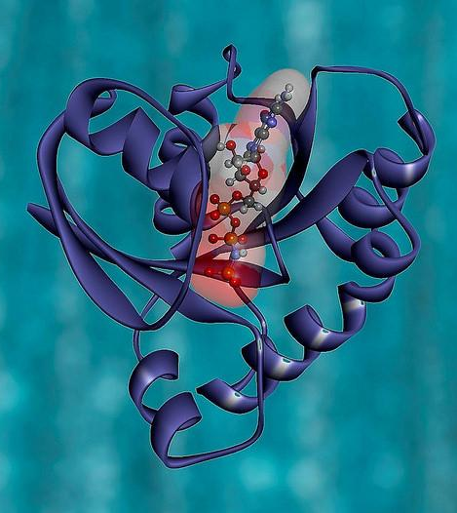
The role of KRAS in panitumumab efficacy
An earlier pivotal phase III study of panitumumab as monotherapy in the mCRC setting provided evidence that clinical beneﬁt was speciﬁc to patients with wild-type (WT) KRAS tumors.
The PRIME study was designed to compare the treatment effect in all patients but was amended to focus on prospective hypothesis testing in the WT KRAS stratum.
KRAS testing was initiated after the study population was enrolled.
Illustration of the KRAS protein. Image credit: National Institutes of Health

Slide 13
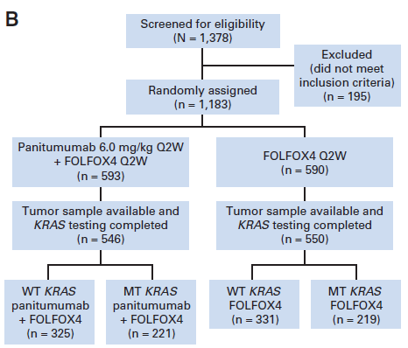
PRIME Study Eligibility Criteria
18+ years old
Untreated metastatic colon or rectal cancer
ECOG performance status (physical function): 0-2
One measurable lesion

Slide 14
The PRIME study population
1183 patients were randomized from Aug 2006-Feb 2008
See trial Table 1
Average age ≈ 62 years
60% had WT KRAS; 40% had mutant KRAS
Trial conducted primarily in Western Europe, Canada, and Australia (not the US)
66% had colon cancer; 34% had rectal cancer

Slide 15
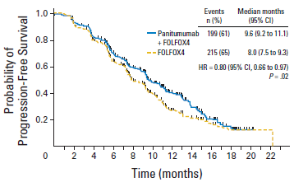
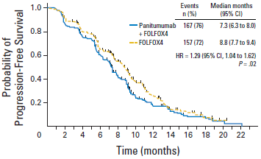
PRIME Study Findings
In May 2014, the Food and Drug Administration approved panitumumab in combination with FOLFOX for the first-line treatment of mCRC for patients with wild-type KRAS tumors (assessed using the therascreen KRAS test)

Slide 16
Who is the target population?
TRIAL POPULATION
Population: PRIME Study Eligibility
Place: Ex-US
Time: 2006-2008
TARGET POPULATION
Population: Meets PRIME eligibility with KRAS wild-type tumors
Place: US
Time: 2010-2017
Notes:
It depends on the perspective for decision-making:
Patient / Caregiver
Oncologist
Payer
Regulator
Researcher

Slide 17
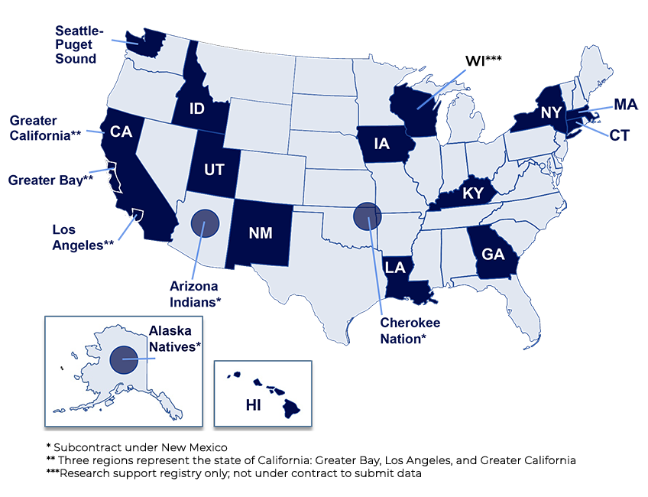
Surveillance Epidemiology and End Results (SEER) Program Registries
Population-based cancer registries
35% of US population
Publicly available data
Demographic, tumor and vital status data
Important notes for workshop:
KRAS mutation status is not recorded in publicly available SEER data.
We simulated 90% of the SEER population to have wild-type KRAS and 10% mutant KRAS to reflect a population likely to receive panitumumab.

Slide 18
Our goal for today
PRIME Trial: 2006-2008
Demographics
Tumor characteristics
Outcomes
Treatment effects relevant to trial population
SEER
2010-2017
Demographics
Tumor characteristics
Weighted PRIME Population
reflect target population
Treatment effects relevant to the SEER target population

Slide 19
Questions? jennifer.lund@unc.edu mawc@live.unc.edu akeil@unc.edu westreic@email.unc.edu

